Slide 1




March Data Crunch Madness
Team WH2T
Tiange Li
Tianlang Yang
Weihang Ouyang
Haojun Li

Slide 2
Introduction
Background: NCAA Men’s basketball Tournament is a single-elimination tournament, currently featuring 68 college teams.
Objective: Generate an effective model that detects important features to a team’s performance and try to identify useful rules.
Result: As can be analyzed from the model, new generated features has a large effect on game results, which are helpful to predict
Win/los
Winning probability

Slide 3

Flow Chart
Data processing (python)
Understand the data structure
Represent games with ratio or difference
Fill missing ranking with ‘26’
Visualize data set
Conclusion
For games
For researchers
Feature Selection (Borutapy, Gplearn)
Delete features using prior knowledge
Generate features with Gplearn
Delete features with Borutapy
Delete collinear features
Model Explanation: (Shap,Pdpbox)
Feature contribution
Feature interaction
Single game explanation
Overall result explanation
Ensembling: (Mlxtend)
Bagging single model
Voting base models
Stacking base models
Result: logloss around 0.42
Baseline establishment (Keras, Tpot)
Setup a neural network with one hidden layer and one dropout layer
Save auto-ml results from Tpot
Baseline: logloss around 0.52
Classification: (mainly tree based)
ExtraTrees Classifier
RandomForest Classifier
LightGBM Classifier
Catboost Classifier
MLP Classifier
Logistic Regression
Adjustment (Eli5, Lime)
Tune best single model
Visualize model results

Slide 4
Independent and dependent variables
2/3 point field goals, assists, steals, block shot
Box score
Distance, host, slot
Independent Variables Clusters
Using pretrained model
Dependent Variable:
Win
Lose
Location
Estimation
Feature selection
Delete collinear model
Defensive efficiency, offensive efficiency, seed
Coach ranking, career overall wins, school overall wins
Coach
experience

Slide 5
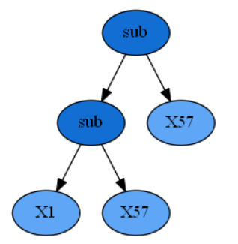
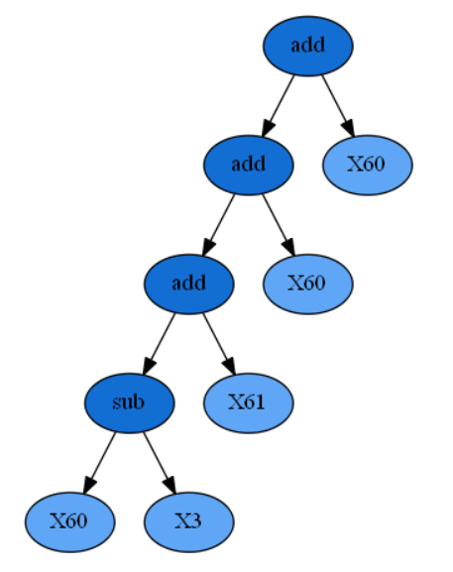
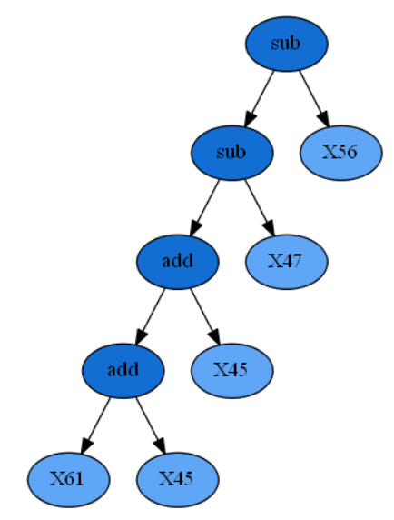

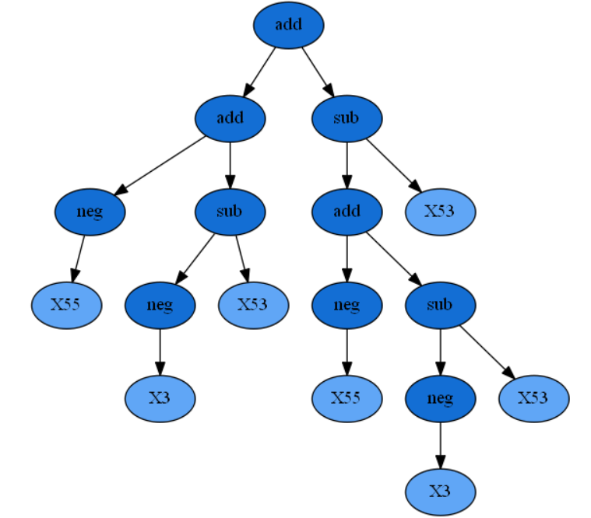
Generated Magic Features
gp_exp : gp_coach : gp_score : gp_supp :
X1: exp win
X57: coach before final
X60: coach preseason
X61: ex coach before final
X3: seed
X56: score dis
X47: f3 score dis
X45: ap progress
X61: pct score
others
This algorithm stimulate the natural evolving process to choose features according to their fitness to find a near-optimal solution using genetic algorithm.

Slide 6
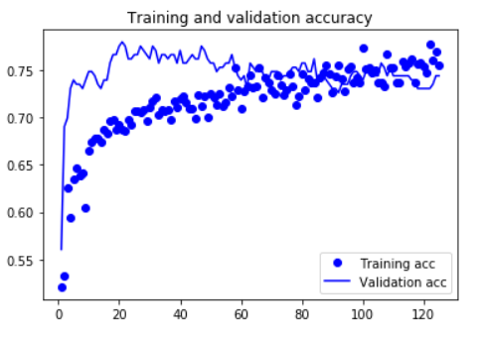
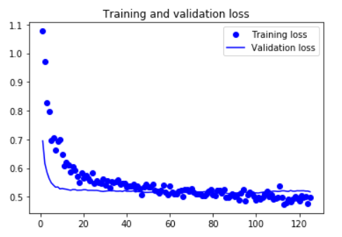
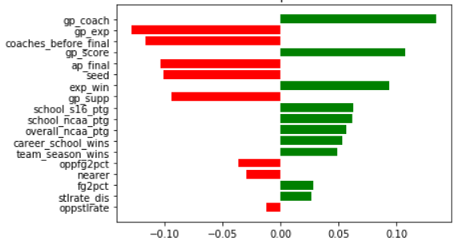
Baseline
The two above figures are results of our baseline, Keras neural network.
Accuracy 72%
Logloss 0.53
The below figure shows the permutation importance.
Get general intuition
Confirm the correctness of our magic features.

Slide 7
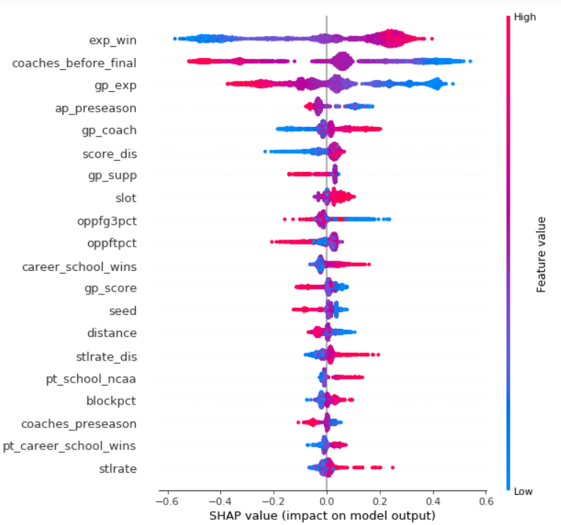
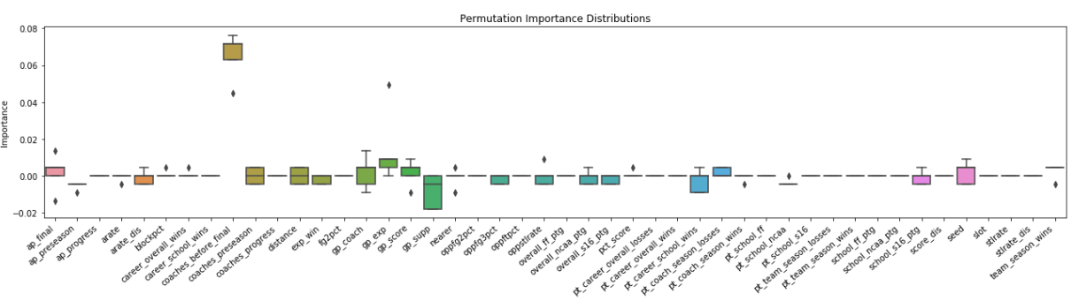
Best single model explanation --features
Important original features:
Coach ranking before final, Final Ap poll team ranking
Opponents 3 points field goals, Opponents free throws
Coach wins at current school
Steals rate, Seed, Distance
Interesting Findings
Coach ranking (final) is more decisive than seed
A team’s opponents average goals are more informative than itself
Distance has some importance

Slide 8
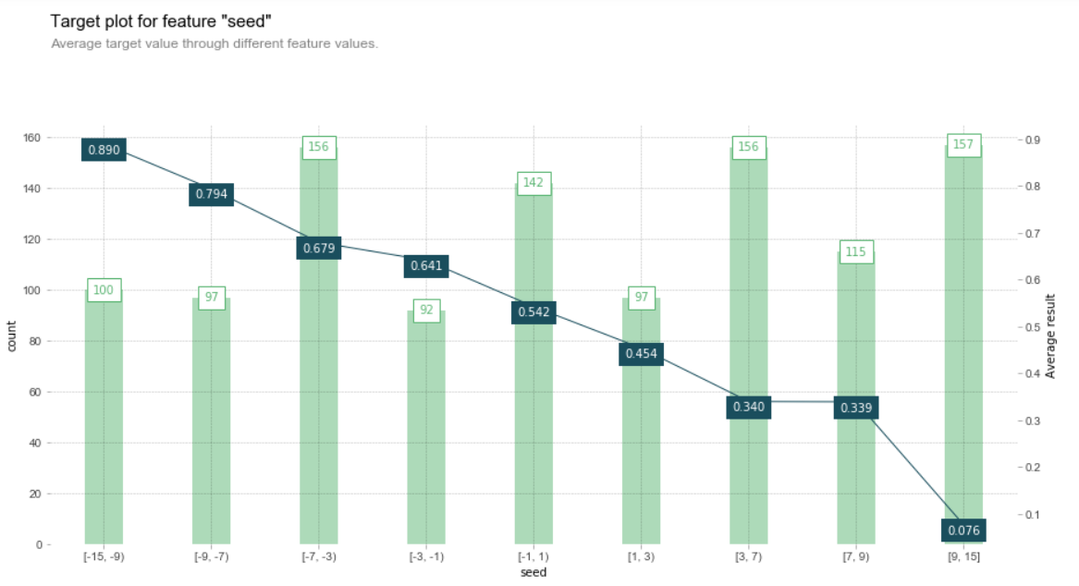
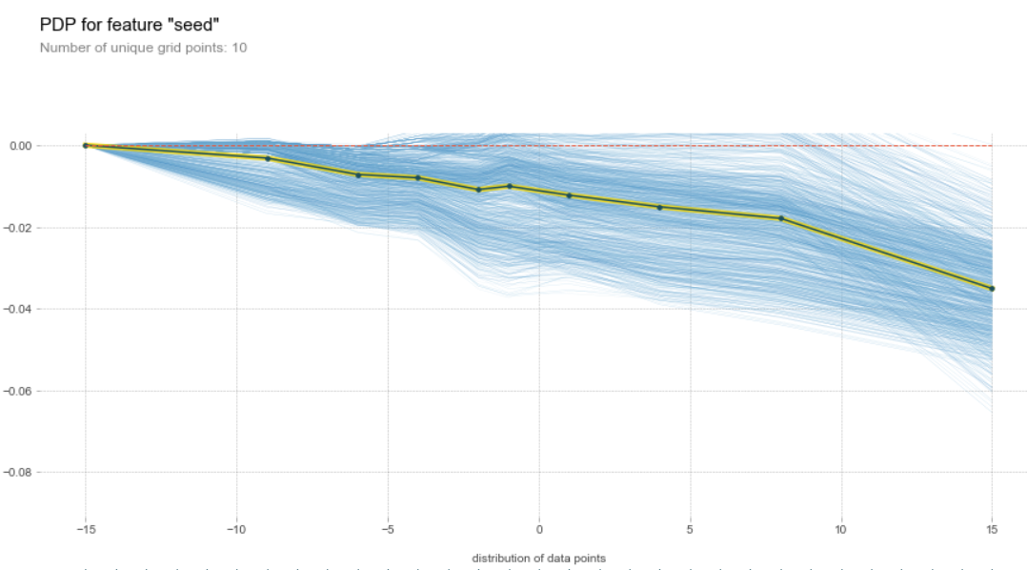
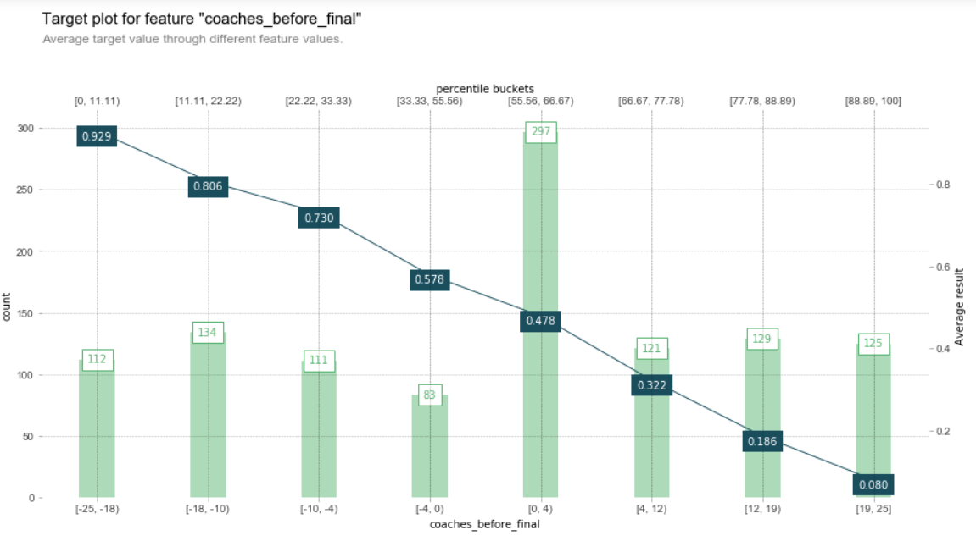
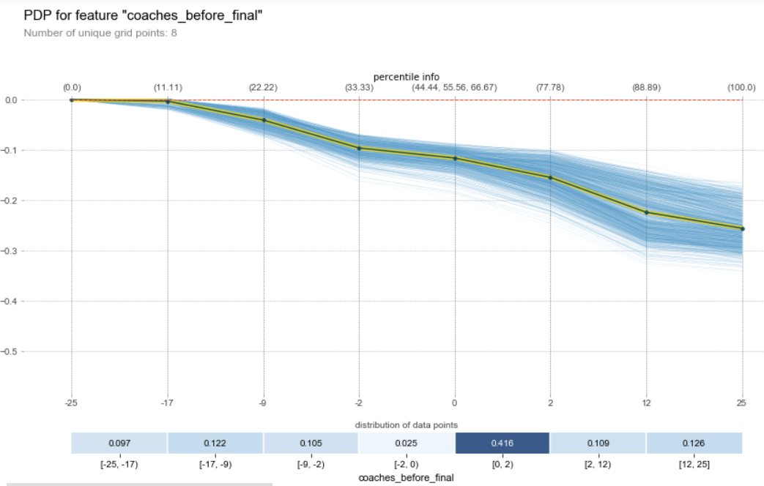
Finding: Coach ranking difference is more decisive than seed difference
From 2 left pictures:
The winning probability changes more monotonically with coach ranking than seed ranking.
However, seed difference distributed more evenly, since many coach ranking is initially unknown.
From 2 right pictures:
Blue area represents potential variation range. The area with coach ranking has less chaos than seed ranking

Slide 9
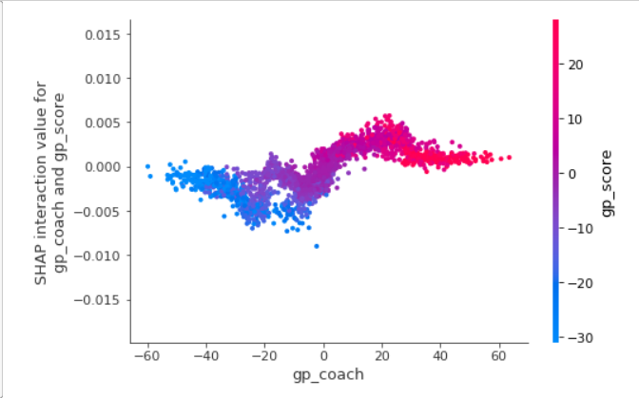
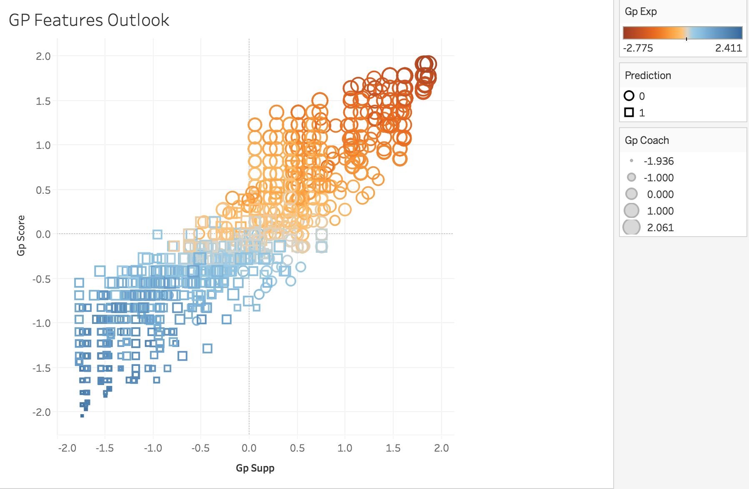
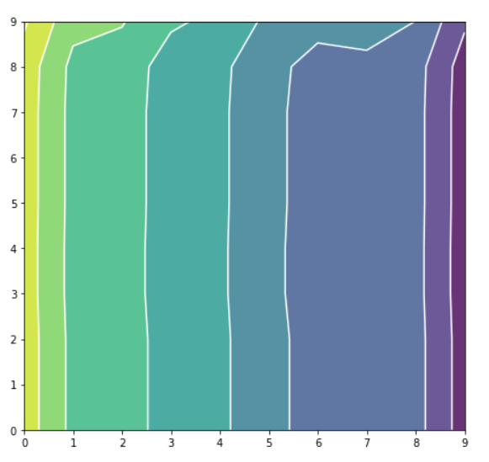
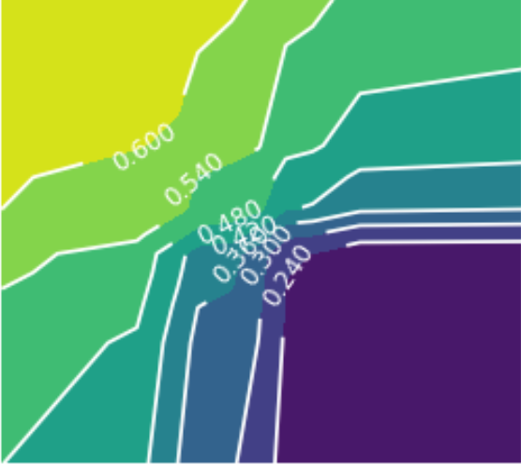
Permutating magic features
The left picture is the pre-analysis of gp features correlation.
The right pictures are gp features interaction considering output value.
We can find that :
The correlation becomes less monotonical. It is only significant in a certain range.
Outside that range, we should consider more about original features.
modeling
Pre analysis
modeling

Slide 10
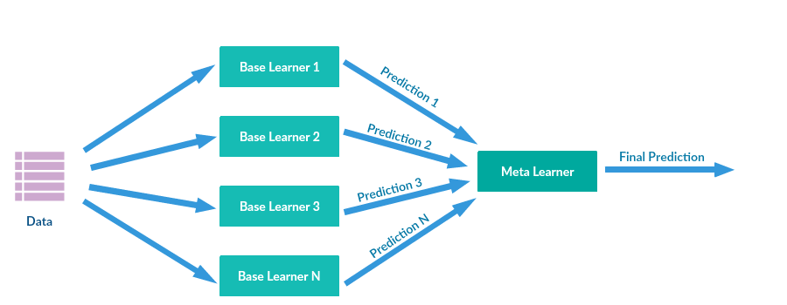
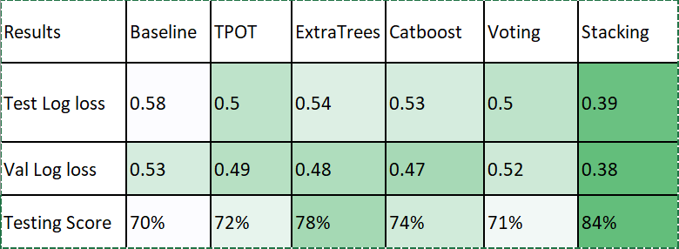
Multiple models stacking prediction
Interesting Findings:
An considerable improvement from baseline to single model and from single model to stacking.
The automated machine learning TPOT tool, using genetic algorithm, achieves best single model result.

Slide 11
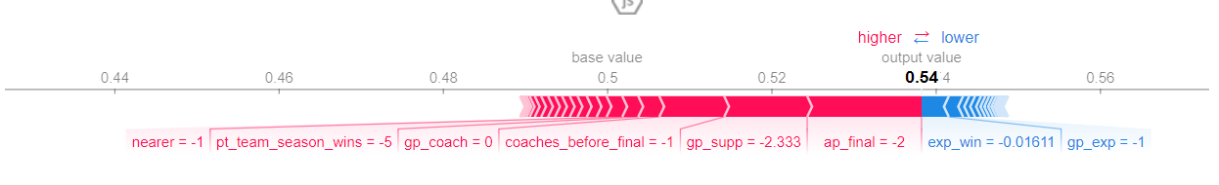
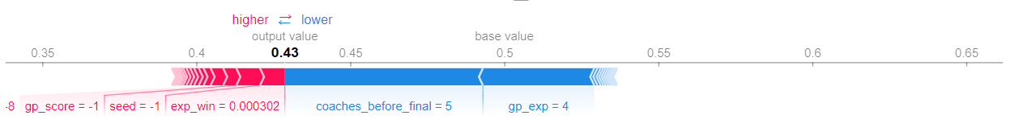
Game analysis
0.5 is set as base value to prevent prior assumptions
In this single game prediction, there are many features tend to increase the output value, most typically, final team rank and team winning history (for Duke). However, the estimation of winning probability is not so positive and our chief magical feature gp_exp prevent it from keep increasing. (correct prediction)
However, sometimes the generated feature might overwhelm other predictors when combined with other major feature. In this case, seed, estimation of winning and gp_score all tends to increase the output value. However, chief magic feature gp_exp combined with coach ranking difference drag it down to 0.43. (wrong prediction)

Slide 12
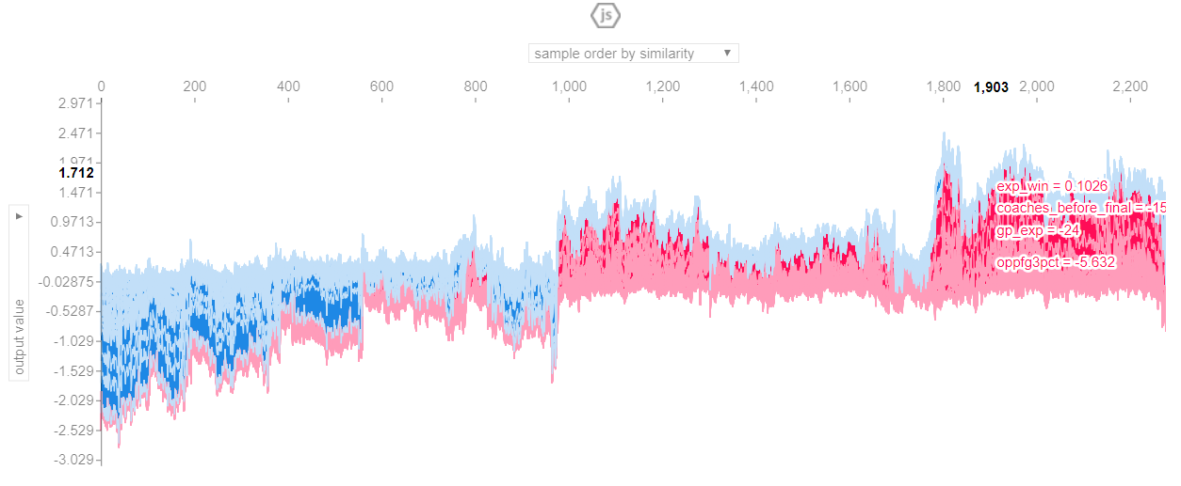
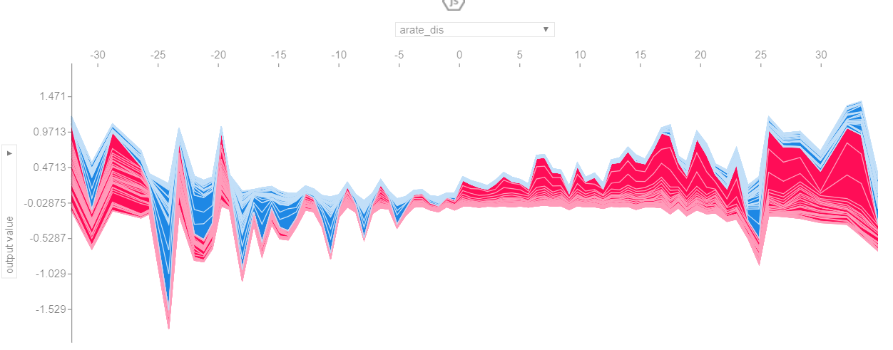
SHAP value analysis
Figure 1: All features impacts to output sample order by similarity
SHAP value interprets the impact of having a certain value for a given feature in comparison to the prediction if that feature took some baseline value.
In this case, we can see the feature impact with regard to all other features. In figure 1, samples show inner correlations, considering the trend of blue and red .
Figure 2 shows the impact of assist distance impact. We can find that this assist rate is only informative at extreme values.
Figure 2: assist rate distance impacts to output value
For complete interactive dashboard with JavaScript please visit github:
https://github.com/Teagan0207/sycamore/blob/master/WH2T.html

Slide 13
Conclusion
For games:
The most important features are defensive and offensive efficiency
A better coach is better than a better seed ranking.
A team’s level is better represented by its average opponents level.
For researchers:
Genetic algorithm is worthy of exploring further. Since both the best model and magic features come from it.
Boruta method seems to be a better method than others in our case, namely dimension reduction and feature selection methods from “sklearn”.
Based on our final model of
Around 0.4 log loss
Around 80% accuracy

Slide 14
References :
[1] https://github.com/vecxoz/vecstack#4-what-is-stacking
[2] https://catboost.ai/docs/concepts/python-reference_parameters-list.html
[3] https://towardsdatascience.com/tpot-automated-machine-learning-in-python-4c063b3e5de9

